Slide 1
INTEGRATED BEHAVIORAL HEALTH MODEL
Integrating Substance Use, Mental Health, and Primary Care Services in Our Communities:
"Disruptive Innovations and Sustaining Change"
Erica Gomes, LCSW
Gabriela de la Torre, MA, MCRP
October 24, 2018

Slide 2
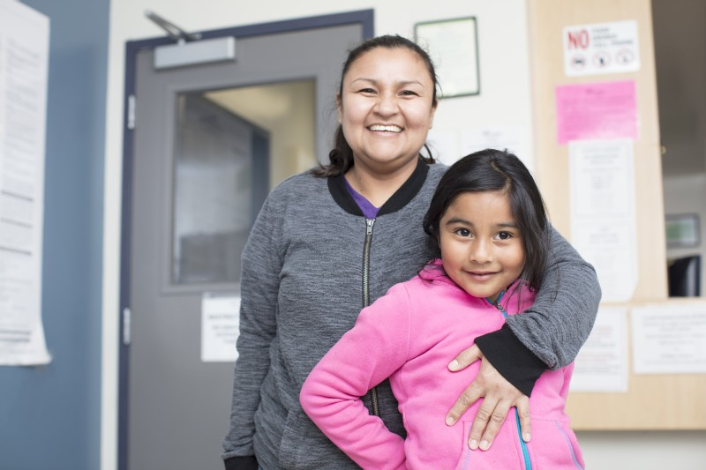
Agenda
Background
Integrated BH Health
Cultural concepts and values when working with Latino populations
Our Model
Our Services
Adaptations of the model
Screening
SUD

Slide 3
La Clínica‘s History
Founded in 1971
By UC Berkeley Students
Volunteer run and free clinic
And then…
Provided medical, dental, optometry and case management
Notes:
Founded in 1971 as storefront on Fruitvale
By UC Berkeley Students (Joel Garcia, David Hayes Bautista, & Jose Velasquez )
Provided medical, dental and optometry
Volunteer run as a free clinic during first year
And then…..
1987 opened 1st Teen Clinic (CAV); 1993 - 1st SBHC (Hawthorne); 1997 – 1st high school SBHC (TechniClinic)
Now 35 locations (incl. 8 SBHCs)
3 counties: Alameda, Contra Costa, and Solano
In 2017, La Clínica served over 86,000 patients and provided 360,570 patient visits
One of the largest community health centers in CA
La Clínica’s target population is residents earning less than 200% of the federal poverty level, Latino immigrants, and residents with public insurance or who are uninsured.

Slide 4
La Clínica‘s History
2005: Introduce Behavioral Medicine
2007: first Behavioral Medicine Specialist (BMS) was hired
Case manager roles expanded to include clinical treatment (IBHCs)
BMS role expanded to include more assessment and treatment
Notes:
originally to primarily provide consultation to medical providers (Strosahl model)
Case Management names and the position was renamed: Integrated Behavioral Health Clinician

Slide 5
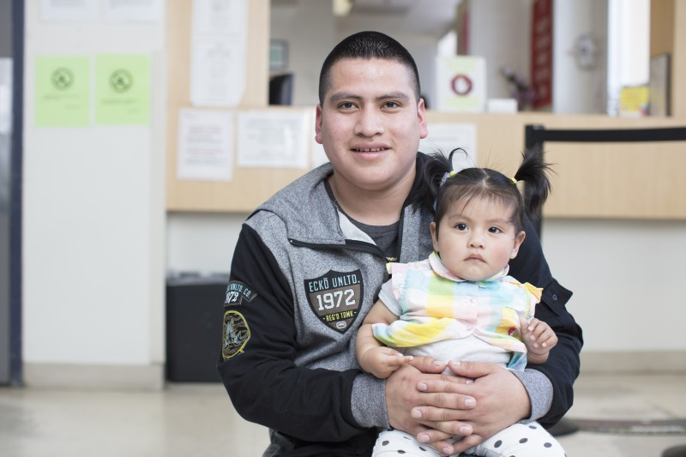
Our Clients

Slide 6
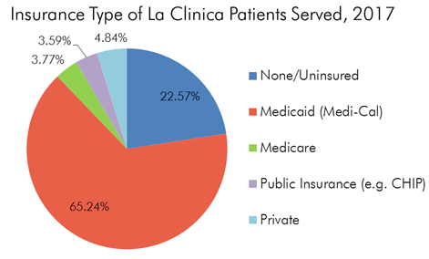
Our Clients

Slide 7
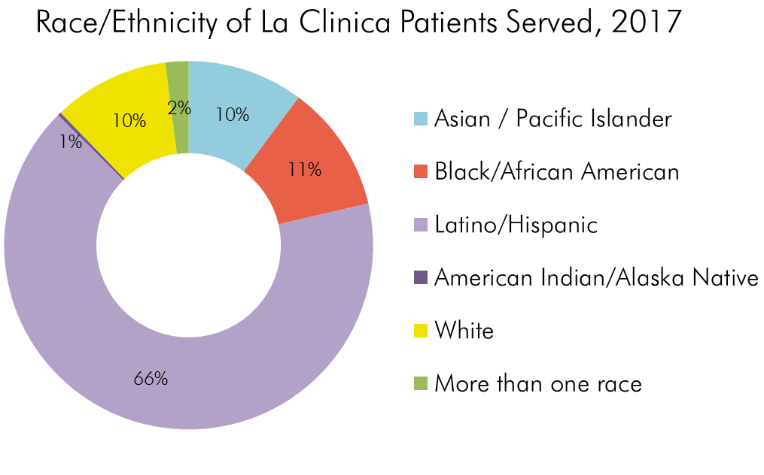
Our Clients

Slide 8
Cultural Concepts and Values

Slide 9
Cultural Concepts and Values
Barriers to care: stigma, insurance, discriminatory policies, MH utilization rates, language and cultural competence of professionals, vulnerable populations….
Personalismo: relationships are everything; WHO and relationships impacting outcomes
Familismo: recognition of strong family connections/role this plays in patient care
Machismo/marianismo: integration of concepts in care approaches; openness/inquiry around concepts
Respeto: deference and how this impacts care

Slide 10
Cultural Concepts and Values
‘susto’ and somatic complaints
Role of psychoeducation: dx, medications, therapy
Role of religion/faith
Asking questions; patient as expert
Indigenous populations; linguistic/cultural diversity
Adapting interventions: awareness of political, cultural, environmental contexts
Crossection of ethical/legal issues and immigration status (ie: IPV reporting)

Slide 11
Current Climate
Agency communication: ‘sanctuary building’; waiting room policies; La Maquina info
Patient communication: signage; medical-legal partnerships; safety planning
Patient clinical support: political stress class; curriculum adaptations; individual sessions to support and provide resources
Clinician/provider support: countertransference issues, supportive spaces to discuss impact, activism and information sharing
Notes:
I believe in health for all. La Clínica has always and will continue to serve a diverse patient population - we will not abandon our commitment to provide access to basic healthcare regardless of immigration status. In commitment to our mission, La Clínica will:
Submit an official agency public comment to demand the U.S. Department of Homeland Security (DHS) stop this regulation;
Distribute FAQs on public charge to patients and immigrant families at all clinic sites;
Coordinate trainings for staff on how to discuss public charge with immigrant families; and,
Participate in local, state, and federal efforts to defeat the passing of this regulation

Slide 12
La Clínica‘s Sites
1. Vallejo Medical
2. Vallejo North
3. Great Beginnings
SOLANO
1 BMS
1 IBHC
0.5 CM
1 IBH MA
1 BMS
1 IBHC
0.5 CM
1 IBH MA
1 CM
THE BAY
AREA
4. Pittsburg Medical
5. Monument
6. Oakley
1 BMS
2 IBHC
0.5 CM
1 IBH MA
1 BMS
2 IBHC
1 IBH MA
IBHC
0.5 CM
CO-CO
7. Clinca Alta Vista
8. San Antonio
9. Transit Village
10. School-Based Fremont/TIGER
11. School-Based Hawthorne
2 IBHC
1 IBH MA
1 BMS
2 IBHCs
1 CM
1 IBH MA
4 IBHCs
1 CM
1 IBH MA
1 IBHC
1 IBHC
12. School-Based Havenscourt
13. School-Linked
Fuente
ALAMEDA
14. Davis Pediatrics
15. School-Based Youth Heart Health Center
16. School-Based San Lorenzo High
1 IBHC
1 IBHC
1 IBHC
1 IBHC
1 IBHC
17. School-Based Roosevelt
18. School-Based TechniClinic
1 IBHC
1 IBHC

Slide 13
Why integrate?
Sub-optimal specialty mental health care utilization
Primary Care referral
Barriers to Access
Distance
Transportation
Language
Stigma
Time
Unknown system
Notes:
Between 30% and 50% of patients referred by a PCP to outpatient mental healthcare never make it to their first appointment
Compared to routine primary care, enhanced primary care behavioral health services deliver superior health outcomes for the following conditions: chronic pain, diabetes, obesity, alcohol abuse, tobacco use, depression, generalized anxiety disorder, social anxiety disorder, and panic disorder.
Between 40% and 60% of patients with psychological disorders are still treated exclusively within primary care.
IBH care corrects the historical error in how we understood mental health-as separate from physical health
Management of medications
Mind-body connection
Barriers to care: transportation, stigma related to BH, linguistic/cultural barriers
Meet patient where they are at (in the medical clinic!)

Slide 14
Why integrate?
Integrated Behavioral Health Merges silos of Primary Care and Behavioral Health
Primary care
Access
Specialty Mental health
Primary Care referral
In house IBH services
Notes:
One-stop shop is both efficient and user-friendly
Cross-pollination of knowledge and skills between PCP and BH
Case conferencing complex patients (nobody is alone in their work)
PCP have support for cases that have heavy BH components and BH have support for cases impacted by medical conditions
Use of health care services decreased by 16% for those receiving behavioral health treatment, while it increased by 12% for patients who were not treated for their behavioral health care needs
Depression treatment in primary care for those with diabetes had $896 lower total healthcare costs over 24 months
Innovative approaches to treat comorbid conditions=cost savings

Slide 15
Integrated Models
Consultation model
Treatment based model
Hybrid
Co-location model (not communicating too much)
Notes:
IBH refers to a team-based model of care wherein “medical and mental health providers partner to facilitate the detection, treatment, and follow-up of psychiatric disorders in the primary care setting” (Hogg Foundation for Mental Health, 2008).

Slide 16
Integrated Models
Consultation model
Treatment based model
Hybrid
Co-location model (not communicating too much)
Notes:
IBH refers to a team-based model of care wherein “medical and mental health providers partner to facilitate the detection, treatment, and follow-up of psychiatric disorders in the primary care setting” (Hogg Foundation for Mental Health, 2008).

Slide 17
Our Model
Goal: make BH services accessible to all
Consultation, brief assessment and treatment, monitoring and triage
Course of treatment = 1-10 visits and triage to higher level as needed
‘warm hand-off’ WHO concept utilized for same-day urgent visits Evidenced-based treatments
Group psychoeducation and treatment
Notes:
Goal: make BH services accessible to all, focusing on population health

Slide 18
Our Model
Specialty Behavioral Health
Mild
Moderate
Severe
IBH
Target population: mild-moderate
Higher severity: support to link to specialty BH programs/services
Episodic care
Crisis support
Intergenerational and lifetime course/medical home concept
Notes:
Differs from specialty mental health provider and traditional medical social work
In their capacity as behavioral health providers in primary care, social workers are responsible for routine screenings, consultations with patients and medical providers, and delivery of brief (1-10 visits) evidence-based interventions for common behavioral health problems such depression, anxiety, insomnia, and substance use. Additionally, social workers in IBH settings also collaborate in team-based care for diabetes, heart disease, asthma, chronic pain and other chronic health conditions

Slide 19
How does it work?
Our Model
Warm hand-off’s
Referrals from primary care providers
Team-based care
Shared medical records
Shared treatment plans
Population-focused care
Cross-pollination of knowledge

Slide 20
IBH Team
Clinical Supervisors and Ops. Manager Leadership Team
Case Manager
Bachelor’s Level, not therapists
Integrated Behavioral Health Clinician
Associate Clinical Social Worker (ASW) & Licensed Clinical Social Worker (LCSW)
ASW/LCSWS
Behavioral Medicine Specialist (BMS)
Licensed psychologist
Psychoeducation
Information
Referral
Screening
F/U calls
Resource needs
Assessment
Brief counseling
Diagnosis
Brief Psychotherapy
Crisis Intervention
Linkage & Rererral
Consultation
Brief Treatment Differential Diagnosis Brief Evaluations
Chronic Pain
Cognitive Impairment ADHD
Medical Co-morbidity
IBH MA supports all three roles
Notes:
Assessment: appropriate level of care; patient needs (linkage, counseling, crisis support?)
Brief counseling: for mild-moderate presentations
Higher severity: monitor, support, psychiatric consultation
Crisis Intervention: safety planning, crisis support; consultation with supervisors
Linkage and referral: community resources, some clinics have special slots/groups for this
Support for PCPs for mandated reporting (CPS, APS, IPV)

Slide 21
Treatment Modalities
Cognitive Behavioral Therapy (CBT)
Motivational Interviewing (MI)
Problem-Solving Therapy (PST)
Solution-Focused Brief Therapy (SFBT)
Mindfulness Based Stress Reduction (MBSR)
Dialectical Behavioral Therapy (DBT)

Slide 22
All ages served
Model Adaptations
Primary Care
Standard
Medical Visits
50/50
model
Teens
School-Based
Youth all ages
Notes:
Get the name of the CBITS screener

Slide 23
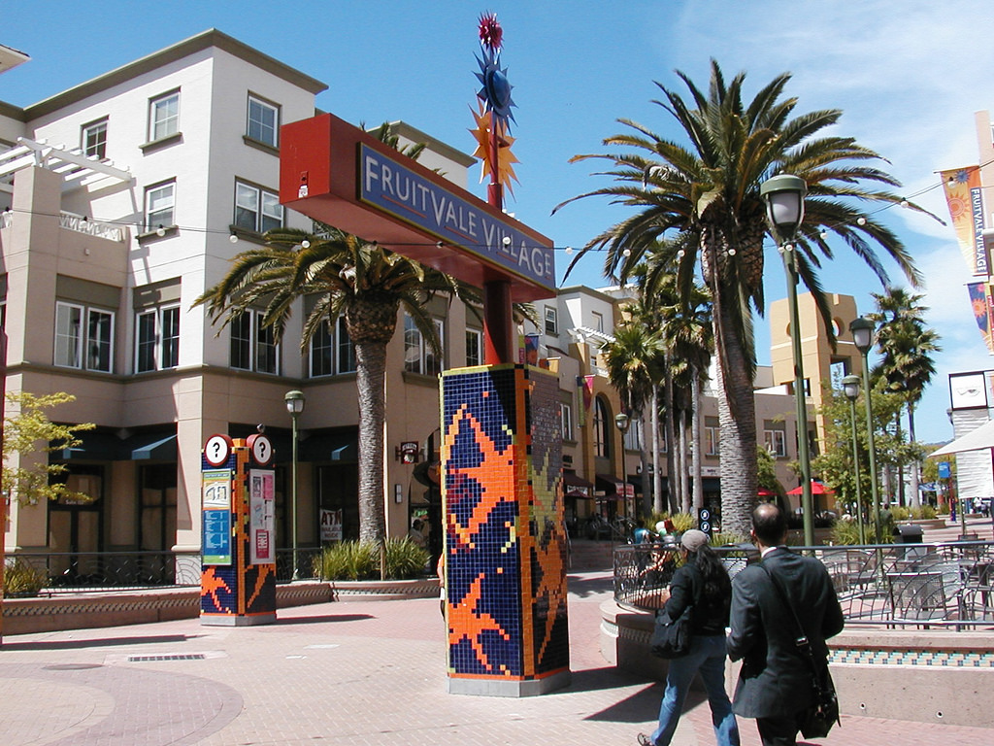
All Ages Primary Care
Models of Care

Slide 24
All Ages Primary Care
Models of Care
BH Care linked to Pediatric, Adult Medicine & Women’s Clinics
Team = 2-4 IBHCs, 1 psychologist
Consultation and Warm Handoffs
Group Treatment:
Depression/Anxiety
Mindfulness
Postpartum Depression
Trauma/Seeking Safety

Slide 25
Clínica Alta Vista
Models of Care

Slide 26
Clínica Alta Vista
Models of Care
Integrated BH and primary care for adolescents 12-23 years old
Confidential services/minor consent
Centering pregnancy
and Centering Parenting
50/50 model of care for
optimal access
Care for children of
adolescents

Slide 27
School-Based Health Center
Models of Care
Notes:
Grants to support trauma-informed practices within clinic & on campus
Grants to support trauma-informed practices services within clinic & on campus

Slide 28
School-Based Health Center
Models of Care
Located on or linked to school campuses and open to community
Micro teams: 1 PCP, 1 IBHC, Medical Assistant, Health Educator
Participation in COST teams
Assist with school-wide crises and interventions
Grants to support services within clinic & on campus
Groups:
Cognitive Behavior Intervention for Trauma in Schools
Grief
Newcomers
Notes:
School-based health centers located on school campuses (in some sites also serving surrounding community)
Brief assessment, treatment and intervention of school (and community) population
Participation in COST meetings to coordinate care
Closed groups for trauma, grief and newcomer adjustment
Crisis support for school-wide incidents
FERPA v. HIPAA
Grants to support trauma-informed practices services within clinic & on campus
The Coordination of Services Team (COST) is the learning support umbrella structure that brings together all support service providers at a school site.: The Coordination of Services Team reviews and discusses student academic/ emotional/ behavioral concerns and generates more interventions as needed.

Slide 29
The The Case for Screr th
Importance of
BH Screening
Identifying patients who need BH support
Triaging need
Tracking symptoms and progress
Practice standard; understood by all service providers
Psychoeducational tool for patients
Gauging severity of symptoms; diagnostic info
Annual screen
•

Slide 30
The The Case for Screr th
Importance of
BH Screening
BH Universal screening:
Yearly screen
Given at primary care appointments
PSQ screening:
Given at all IBH appts.
Given by PCP if referring to IBH
Annual screen
•
Notes:
Yearly screen for depression and substance use in all patients 12y/o and older; yearly screening for trauma and s/s of concern for under 12y/o
Given at primary care appointments; if positive, brief intervention and refer to IB
PSQ Given at all IBH appts appointments for patients 12y/o and over;

Slide 31
Annual BH Screen
Screens

Slide 32
Patient Stress Questionnaire
Screens

Slide 33
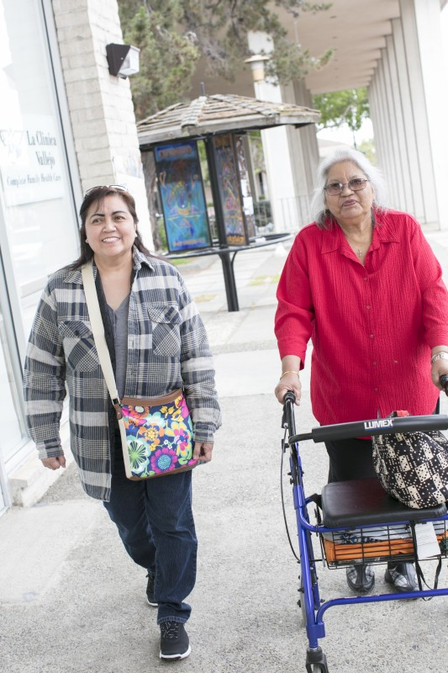
PHQ-9 GAD-7 PCL-5 UNCOPE CRAAFT PSQ
Standardized
Assessment
Tools

Slide 34
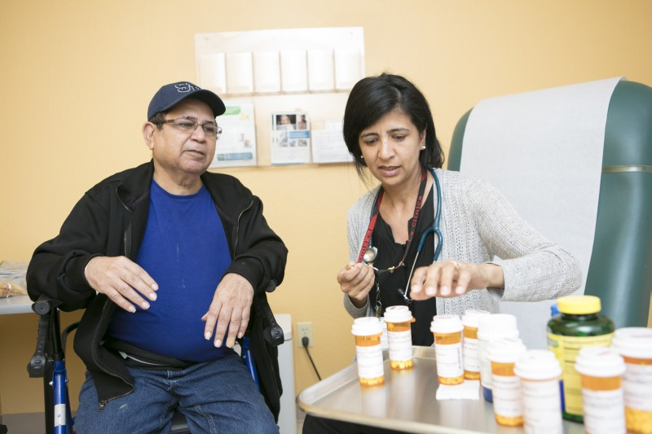
Substance Use
Screen for substance use through the UNCOPE & CRAFFT screen
1 or more X waivered physicians are all primary care sites
Active Chronic Pain and Opioid Use Disorder Committee
Notes:
Expanding MAT for OUD as well as the health center’s overarching SUD goals by building internal capacity to support primary care and mental health
providers in working with SUD and MAT patients. La Clínica de La Raza, Inc. (La Clínica) proposes hiring a 1.0 FTE Certified Alcohol and Drug Addiction Counselor (CADAC I,
referred to as SUD Counselor) and a .2 Registered Nurse (RN) who will provide direct support to La Clínica patients with SUDs. Specifically, the SUD Counselor will provide shortterm
SUD counseling and the RN will follow up directly with patients regarding medications in order to monitor patient progress and ensure correct dosage. The addition of these
positions will allow Primary Care Providers (PCP) to have increased confidence in initiating MAT because a workflow is in place to support patients during the process. The
ongoing staffing additions are further complemented by the addition of .3FTE MAT Champions during year one (1) of the grant. The MAT Champions are PCPs who have subject
area expertise in MAT and are able to support newly DATAwaivered
PCPs by discussing concerns regarding MAT, developing and deploying small targeted updates and trainings
during staff meetings, and answering inbox questions. As a direct result of the above supports, La Clínica projects providing an additional 30 existing La Clínica patients with MAT.
La Clínica’s goal is to adequately meet the needs of the agency’s patient population and provide them with an integrated approach to SUD services by offering SUDspecific
counseling in the primary care setting. Using onetime
funding during year one (1) of the grant, La Clínica will hire a consultant to conduct an agencywide
analysis on current SUD
services and workflows to define gaps in agency structure. This analysis will further poise La Clínica to be prepared for future expansion opportunities by building out the agency’s
integrated SUD service approach. The consultant will also be available to provide oneonone
counseling support for PCPs working on difficult MAT cases. La Clínica’s Chronic
Pain and Opioid Use Disorder Task Force, which has met monthly for over five (5) years, has been used for visioning around La Clínica’s SUD services and will continue to be a
space for future visioning work further supported by the addition of a consultant.

Slide 35
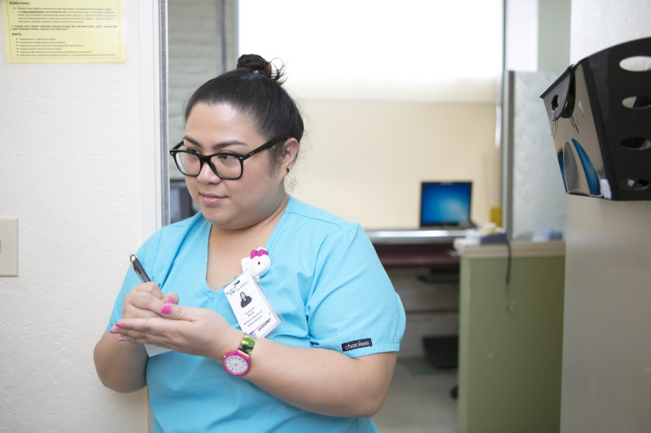
Substance Use
Recipient of HRSA award to expand MAT across all 3 counties
new CADAC counselor to assist Providers &Patients
IBH and Medical coordinating to provide support and supervision for CADAC counselor
Notes:
Expanding MAT for OUD as well as the health center’s overarching SUD goals by building internal capacity to support primary care and mental health
providers in working with SUD and MAT patients. La Clínica de La Raza, Inc. (La Clínica) proposes hiring a 1.0 FTE Certified Alcohol and Drug Addiction Counselor (CADAC I,
referred to as SUD Counselor) and a .2 Registered Nurse (RN) who will provide direct support to La Clínica patients with SUDs. Specifically, the SUD Counselor will provide shortterm
SUD counseling and the RN will follow up directly with patients regarding medications in order to monitor patient progress and ensure correct dosage. The addition of these
positions will allow Primary Care Providers (PCP) to have increased confidence in initiating MAT because a workflow is in place to support patients during the process. The
ongoing staffing additions are further complemented by the addition of .3FTE MAT Champions during year one (1) of the grant. The MAT Champions are PCPs who have subject
area expertise in MAT and are able to support newly DATAwaivered
PCPs by discussing concerns regarding MAT, developing and deploying small targeted updates and trainings
during staff meetings, and answering inbox questions. As a direct result of the above supports, La Clínica projects providing an additional 30 existing La Clínica patients with MAT.
La Clínica’s goal is to adequately meet the needs of the agency’s patient population and provide them with an integrated approach to SUD services by offering SUDspecific
counseling in the primary care setting. Using onetime
funding during year one (1) of the grant, La Clínica will hire a consultant to conduct an agencywide
analysis on current SUD
services and workflows to define gaps in agency structure. This analysis will further poise La Clínica to be prepared for future expansion opportunities by building out the agency’s
integrated SUD service approach. The consultant will also be available to provide oneonone
counseling support for PCPs working on difficult MAT cases. La Clínica’s Chronic
Pain and Opioid Use Disorder Task Force, which has met monthly for over five (5) years, has been used for visioning around La Clínica’s SUD services and will continue to be a
space for future visioning work further supported by the addition of a consultant.

Slide 36
55y/o Latino male referred for chronic pain, gout, ETOH dependence
Case Example 1
Additional factors: severe PTSD from war in El Salvador; coping with ETOH; recent suicidal ideation
What would be key goals for this patient?
What cultural factors could be important to factor in?
What interventions might be helpful in this case?

Slide 37
Intervention
Case Example 1
Goals: decrease SI, decrease ETOH use, decrease active/intrusive symptoms of PTSD, decrease chronic pain
Cultural factors: context of civil war and impact on veterans of war (recruitment against will); machismo (role as breadwinner); respeto (adult Latino male-MH stigma?)
Interventions: risk/safety assessment; psychoed re: fight/flight and PTSD s/s; MI and harm reduction (ETOH dependence); grounding/coping for actue PTSD s/s; longer term care; involving family; support re: obtaining meds (insurance issues); letter for employer re: condition
Outcome: reduced SI, increased hope, decreased dependence on ETOH; increased coping with PTSD s/s

Slide 38
15y/o male newcomer at Oakland public schools. Recent arrival from rural Guatemala; bilingual MAM and Spanish-speaking. Referred as newcomer; experiencing depression (PHQ-9=15); history of cutting when arrived 3 months ago; reunited with family here after being separated for 10 years.
Case Example 2
What would be key goals for this patient?
What cultural factors could be important to factor in?
What interventions might be helpful in this case?

Slide 39
Intervention
Case Example 2
Goals: decrease depression, support acculturation process
Cultural factors: newcomer; grief/loss; reunification; Latino indigenous community
Interventions: safety/risk assessment, distress tolerance/DBT skills (cutting), behavioral activation (depression), CBT and PST around grief/loss, basic resources (legal referral), family-level interventions
Outcome: sustained no self-harm; linkage with soccer group to build community; decreased depression (PHQ-9=5); reconnected with grandmother (phone)

Slide 40
THANK YOU!
Erica Gomes, LCSW
egomes@laclinica.org
Gabriela de la Torre, MA, MCRP
gdelatorre@laclinica.org

